Slide 1
JAVA Lecture 19
Annotations in JAVA

Slide 2
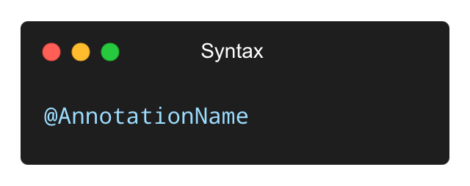
What are Annotations in Java?
• Annotations are metadata (information) added to Java code.
• They do not change the logic of the program but can:
✅ Provide instructions to the compiler
✅ Support code analysis tools
✅ Influence runtime behavior (with frameworks)

Slide 3
Overview of Common Built-in Annotations
Annotation | Purpose
@Override | Ensures method overrides a superclass
@Deprecated | Marks method or class as outdated
@SuppressWarnings | Tells the compiler to ignore specified warnings
@FunctionalInterface | Marks an interface for lambda expressions
@SafeVarargs | Suppresses warnings to varargs

Slide 4
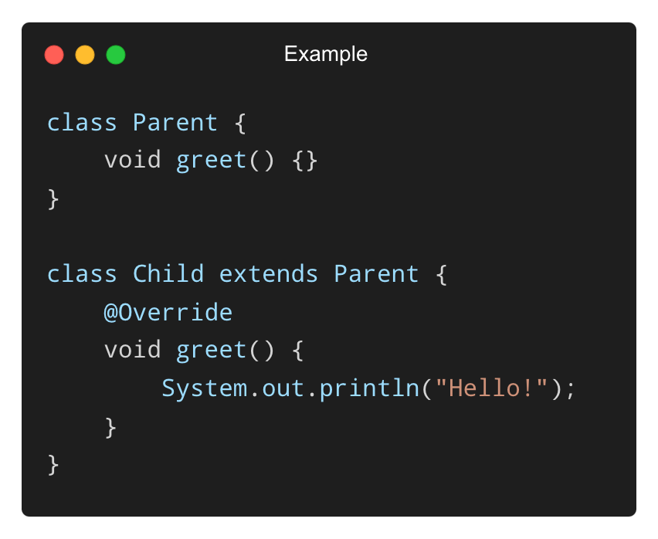
Using @Override Annotation
• Ensures a method overrides a superclass or interface method.
• Helps avoid errors due to incorrect method signatures.
✅ Compiler will give an error if the method does not actually override.

Slide 5
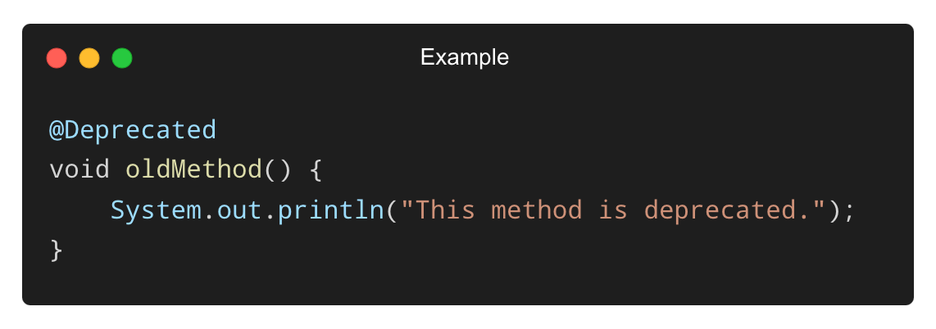
Using @Deprecated Annotation
• Indicates a method or class should no longer be used.
• Useful for phasing out old APIs.
✅ The compiler will show a warning if someone tries to use oldMethod().

Slide 6
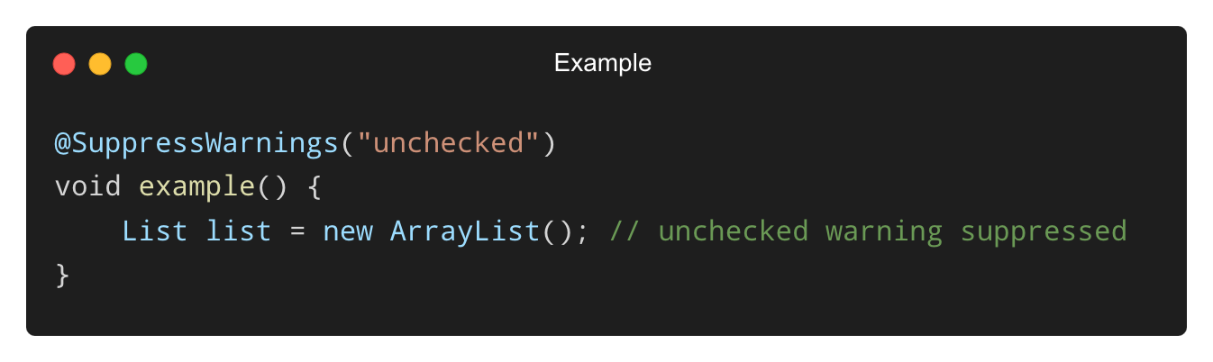
Using @SuppressWarnings Annotation
• Suppresses specific compiler warnings (e.g., unchecked operations).
✅ Use it carefully and only when you’re sure the warning is harmless.

Slide 7
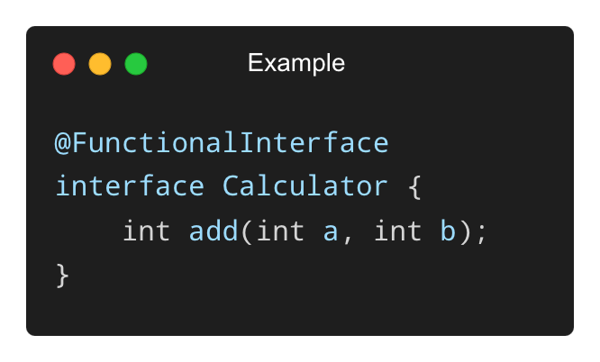
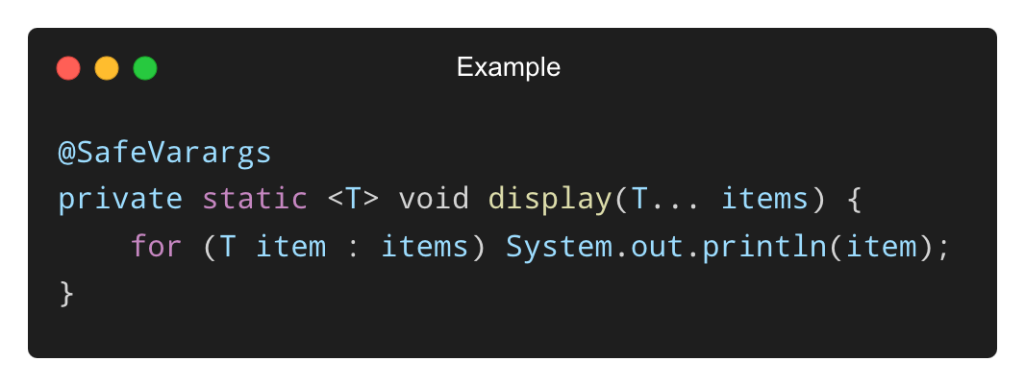
Other Useful Built-in Annotations
@FunctionalInterface – Marks an interface for use with lambdas.
@SafeVarargs – Used with varargs methods to avoid unchecked warnings.

Slide 8
Why Create Custom Annotations?
Custom annotations allow you to:
✅ Mark special behaviors in your code.
✅ Pass metadata to tools, libraries, or frameworks.
✅ Build your own validation or processing rules.
Examples:
@NotNull, @TrackChange, @ToDo
Used in frameworks like Spring, Hibernate

Slide 9
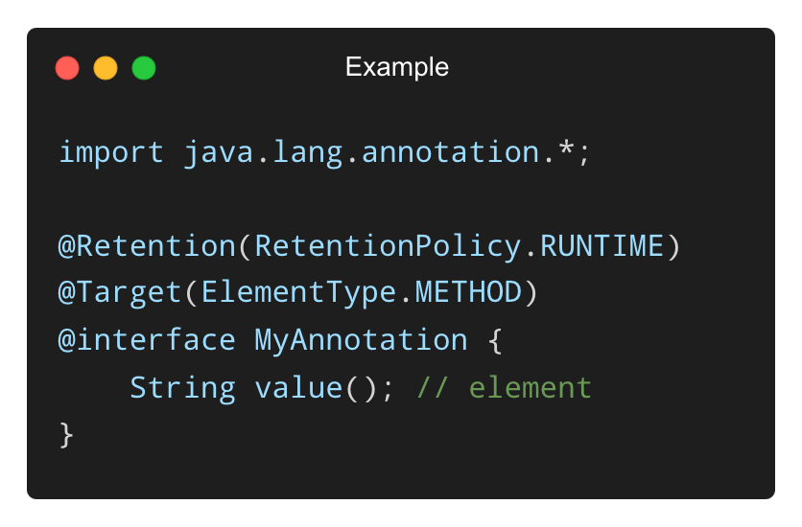
Syntax to Declare a Custom Annotation
✅ Use @interface to declare annotations.
✅ value() is a required element (can be more).

Slide 10
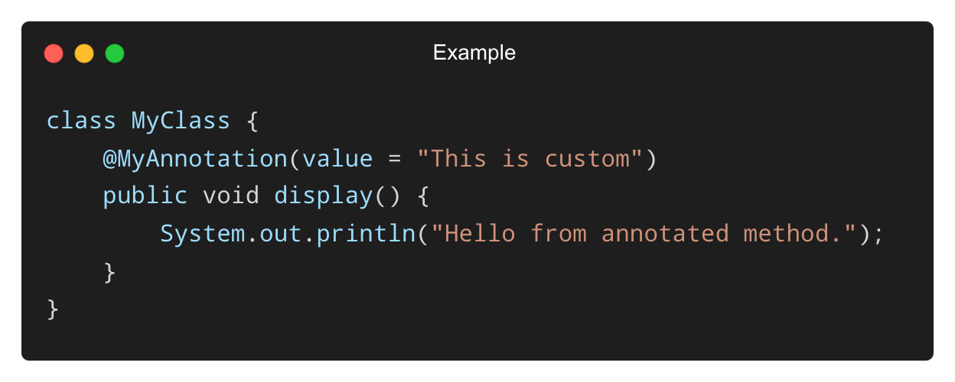
Applying a Custom Annotation
✅ Custom annotations look like regular annotations.
✅ Use them on methods, classes, fields, etc., as per the @Target.

Slide 11
Annotations and Meta-Annotations
Annotation | Purpose
@Retention | Specifies whether annotation is available at SOURCE, CLASS, or RUNTIME.
@Target | Defines where annotation can be applied.
@Documented | Includes annotation in generated JavaDocs
@Inherited | Allows subclasses to inherit annotations
✅ Most common retention policy: RUNTIME
✅ Common targets: ElementType.METHOD, ElementType.TYPE

Slide 12
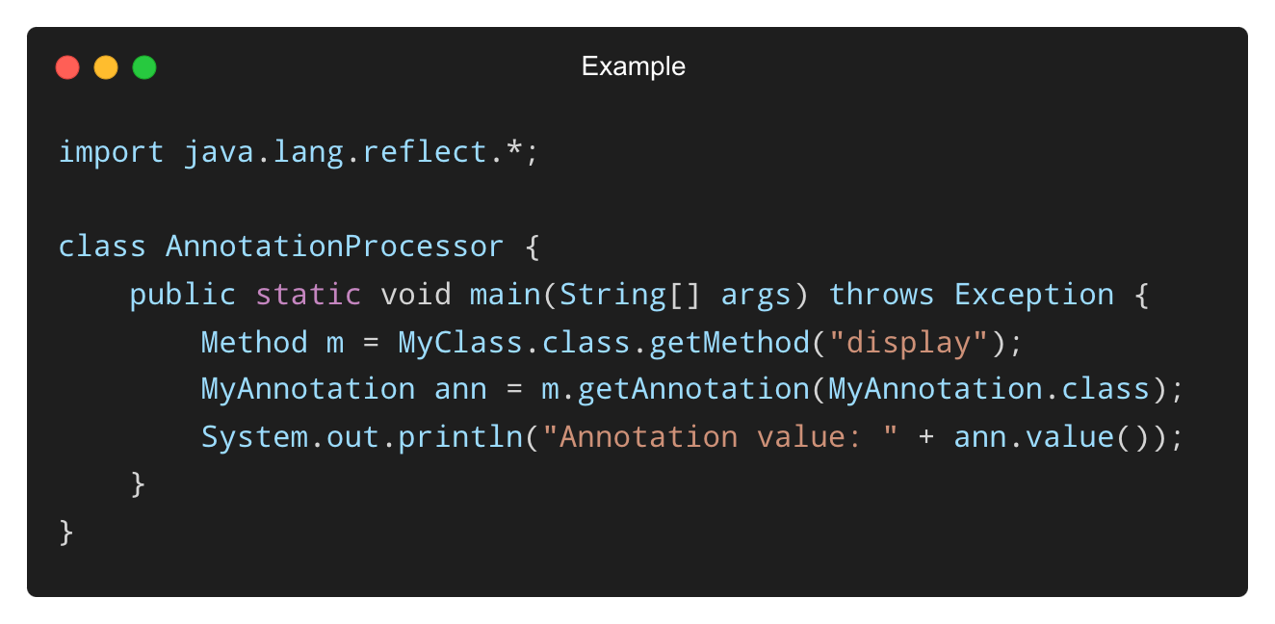
Reading Custom Annotations via Reflection
• Use reflection to process custom annotations at runtime.
✅ Enables annotation-based runtime logic or validation.

Slide 13
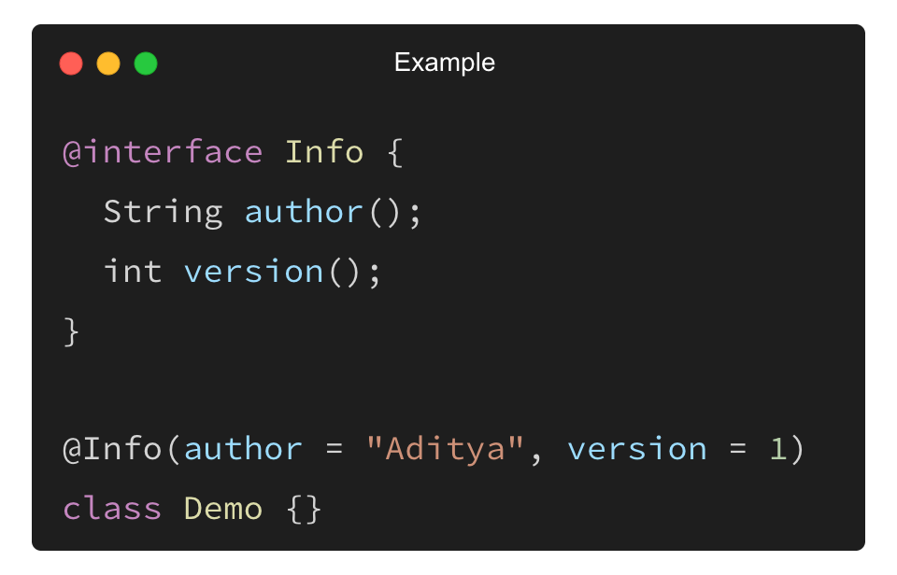
Multi-Value Custom Annotations
• Annotations can have multiple named elements:
✅ Provides structured metadata for tools and frameworks.

Slide 14
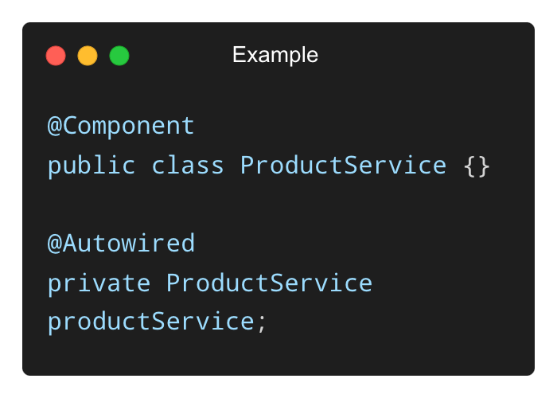
Example - Annotations in Spring Framework
• Spring heavily relies on annotations for dependency injection and configuration.
Explanation:
• @Component: Marks a class as a Spring-managed bean.
• @Autowired: Automatically injects dependencies.
✅ No need to write XML configuration!

Slide 15
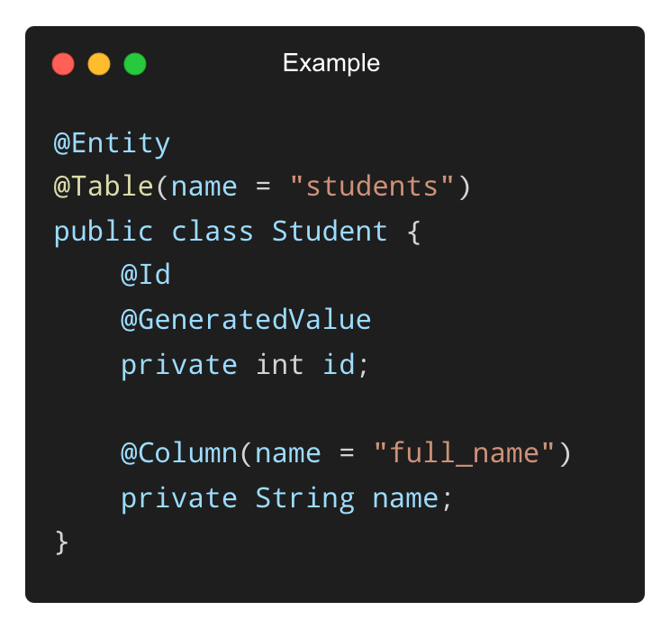
Example - Annotations in JPA/Hibernate
• Used for object-relational mapping (ORM).
✅ JPA (JAVA Persistence API) annotations map Java classes to database tables.
✅ Easy to configure ORM behavior using annotations.

Slide 16
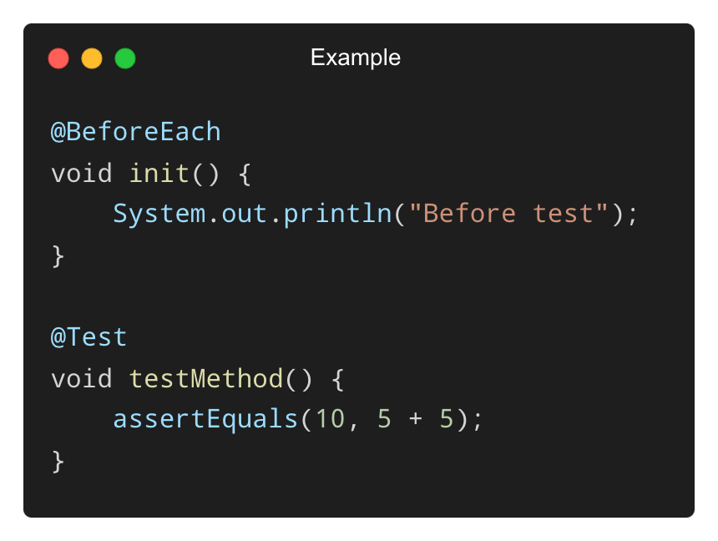
Example - Annotations in JUnit Testing
• JUnit uses annotations to define tests and setup logic.
✅ @Test marks a method as a test case.
✅ @BeforeEach runs code before every test method.

Slide 17
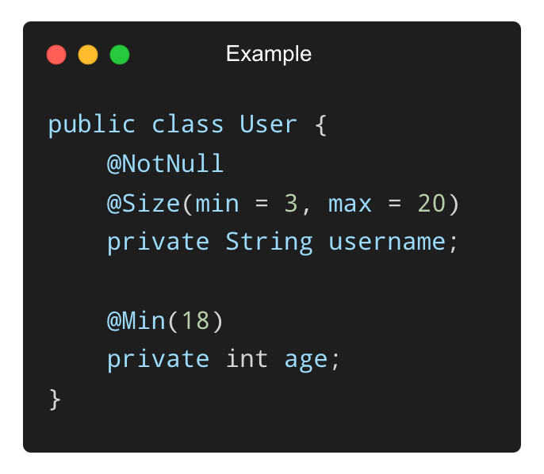
Example - Bean Validation API (Jakarta)
• Used to validate input using annotations.
✅ Helps enforce rules like minimum age, non-null names, etc.
✅ Automatically handled by validation engines like Hibernate Validator.

Slide 18
THANK YOU

